Slide 1
Competitive Cyber Security Organization
GBM – Reverse Engineering
By attending today’s meeting you acknowledge that you may be photographed or recorded for club use

Slide 2
Announcements

Slide 3
Learning Objectives
What is reverse engineering?
Difference between disassemblers and debuggers
What tools to use
Basic Binary walkthrough!
Reverse engineer a Unity game!

Slide 4

What is Reverse Engineering?
Compilers
Machine Code
Assembly
Decompilers
DLLs
Disassembly

Slide 5

Terminology
Source Code – User developed functions for a program
Metadata - Data about Data
CPU – Central processing unit, compiles machine code
Programming languages – C#, C++, Visual Basic
Instructions – Commands in assembly that reflect where data goes and what the code is supposed to do.

Slide 6

Machine Code
Binary
Unreadable by humans
Humans do not deal with machine code anymore, still needs to be understood.
Machines are not smart.

Slide 7
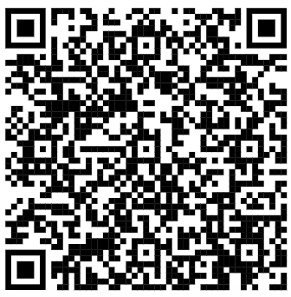

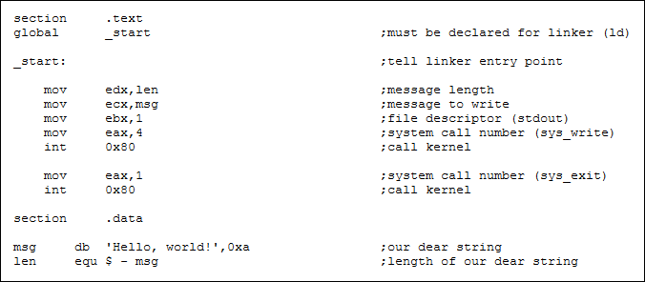
Assembly
Machine code in readable format!
Lists of instructions and operands
Utilizes registries that hold values of data that are moved around by instructions

Slide 8
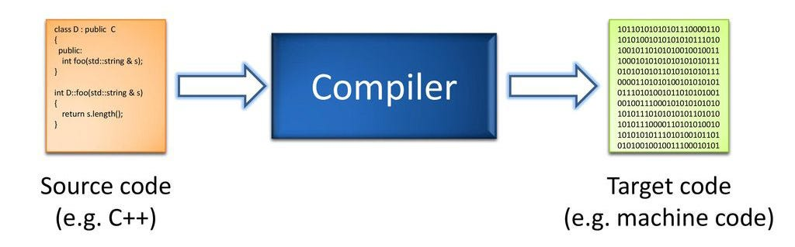
Compilers
Translates high-level code -> readable machine code
Example: C# -> Compiler -> Machine Code (Binary)

Slide 9
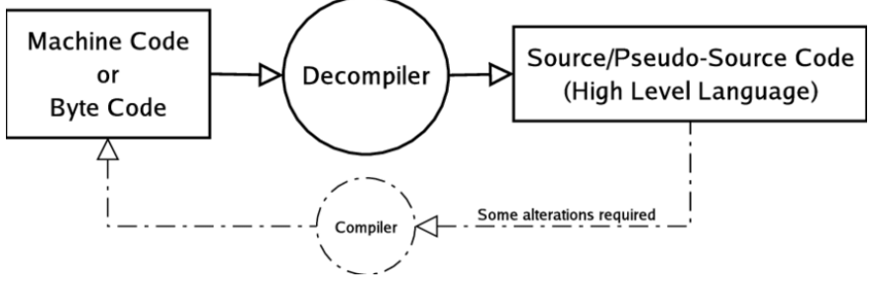
Decompilers
Does the opposite!
Transforms machine code into readable source code (C#, C++, Assembly)
Will decompile the code in a readable format based on the CPU.

Slide 10

Debuggers
Different from a disassembler
Debugging allows you to step into the code while it is running.
Allows you to change values and set breakpoints to alter how the code runs.

Slide 11

DLLs
Dynamically-Linked Libraries
Utilized functions and dependencies created by developers to easily compare and edit code.
Linked during runtime to be ran in a specific order (to build up the executable)

Slide 12
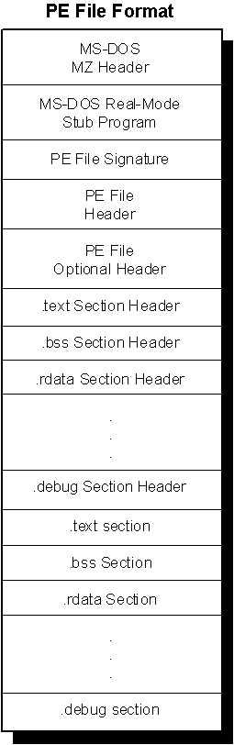
Binary Types
ELF
Executable and Linkable Format
Standard on linux
PE
Portable Executable
File format for executables, DLLs, and more
on Windows

Slide 13
Stripping Binaries & Magic Bytes
Stripping a binary makes it so the compiled version is without the usual debugging information
Harder to reverse engineer
Magic Bytes: First few bytes tell user what file format it is in
4d 5a = DOS MZ executable (.exe)

Slide 14

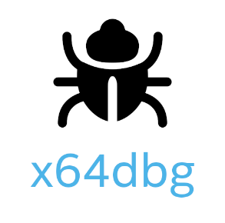
Tools
Disassemblers/Decomp.
IDA Pro
Radare2 (Linux)
Ghidra
IL-Spy
Debuggers
x64dbg
GDB (Linux)
Binja (Binary Ninja)
dnSpy

